Slide 1
FarmEkoX: Smart Crop Advisory System for Small and Marginal Farmers.
CSE7302- University Project
Review-2
Batch Number: CSG_42
Roll Number | Student Name
20221CSG0153 | NAVEEN M
20221LCG0004 | AVINASH N
20221LCG0005 | KURUBA ARUN KUMAR
Under the Supervision of,
Ms. Shet Reshma Prakash
Assistant Professor
School of Computer Science and Engineering
Presidency University
Name of the Program: CSG
Name of the HoD: Dr. Pallavi R
Name of the Program Project Coordinator: Ms. Benitha Christinal J
Name of the School Project Coordinators: Dr. Sampath A K

Slide 2
Content
Abstract
Literature survey
Objectives
Existing methods and drawbacks
Architecture Diagram
Modules
Software details
Timeline
References

Slide 3
Abstract
Farmekox:- is an AI-powered, mobile-first smart agricultural advisory platform designed to help farmers make data-driven decisions for better productivity and profitability. Farmers in regions like Karnataka often face challenges such as lack of timely information, inefficient irrigation practices, limited expert access, and unstable market prices.Farmekox integrates Google Gemini AI through the Genkit framework to provide location-aware crop recommendations, multilingual AI advisory (English and Kannada), real-time weather-based irrigation alerts, fertilizer guidance using barcode scanning, and a direct-to-consumer sales platform.By combining intelligent automation, cloud deployment, and real-time analytics into a single platform, Farmekox aims to improve crop yield, reduce operational costs, and promote sustainable farming practices

Slide 4
Literature survey
The present, day AI in agriculture is on its way to "Hybrid Intelligence" but still, most of it is physically tethered to the infrastructure. Elbasi et al. (2023) pinpointed that, although AI technologies such as Natural Language Processing (NLP) have tremendously evolved, the application of these in agriculture is often lacking a cohesive user interface that the rural population can easily use.
Our research is built on the basis of Khaliq et al. (2025) who found that AI, integrated solutions can highly optimize the process of soil, crop matching. Nevertheless, the main problem with their model is that it heavily depends on lab, verified soil data, which prevents the model from being used instantly in the fields of remote Indian villages. In a similar way, Chantima et al. (2025) devised an efficient solution through the utilization of embedded sensors and Random Forest Regressors, which did reach the notable accuracy level but the expensive hardware cost made it out of reach for the marginal farmers.
One more challenge is the "Black Box" character of these systems. Martin et al. (2024) have stressed that for AI to be embraced by the agriculture community, it has to be "Explainable". From their investigation of the XAI, powered frameworks, they found that giving the "Reason" for a certain crop (for instance, by explaining that Ragi is suggested due to high rainfall and low nitrogen) lead to an increase in the adoption rate of more than 30%.
At last, Liu et al. (2025) and Patel et al. (2025) examined fertilizer management systems and concluded that majority of the present, day solutions hardly consider the low, bandwidth (2G/3G) environments which are quite common in rural India. FarmEkoX closes these loopholes by merging the soil, matching logic of the seminal paper with GAN, based simulation, XAI transparency, and a lightweight Node.js architecture specifically geared for mobile web access.

Slide 5
Objectives:
Develop an AI-driven crop recommendation system based on location, climate, and season.
Build a multilingual AI advisory platform supporting English and Kannada.
Provide weather-based irrigation guidance for water optimization.
Implement a fertilizer calculator with dosage and usage recommendations.
Create a direct sales platform to connect farmers with nearby buyers.
Provide real-time mandi price updates through the Market Watch module.
Design a mobile-first responsive interface for easy farmer accessibility.
Enable location-based resource discovery using Google Maps integration.

Slide 6
Existing methods and drawbacks
Existing Methods:
Farmers depend on manual advisory services
Use multiple apps for weather, pricing, and crop guidance
Traditional selling through middlemen

Slide 7
Existing methods and drawbacks
Drawbacks:
Fragmented platforms and poor integration
Lack of real-time updates
No AI-powered decision support
Language barriers
Reduced farmer profit margins

Slide 8
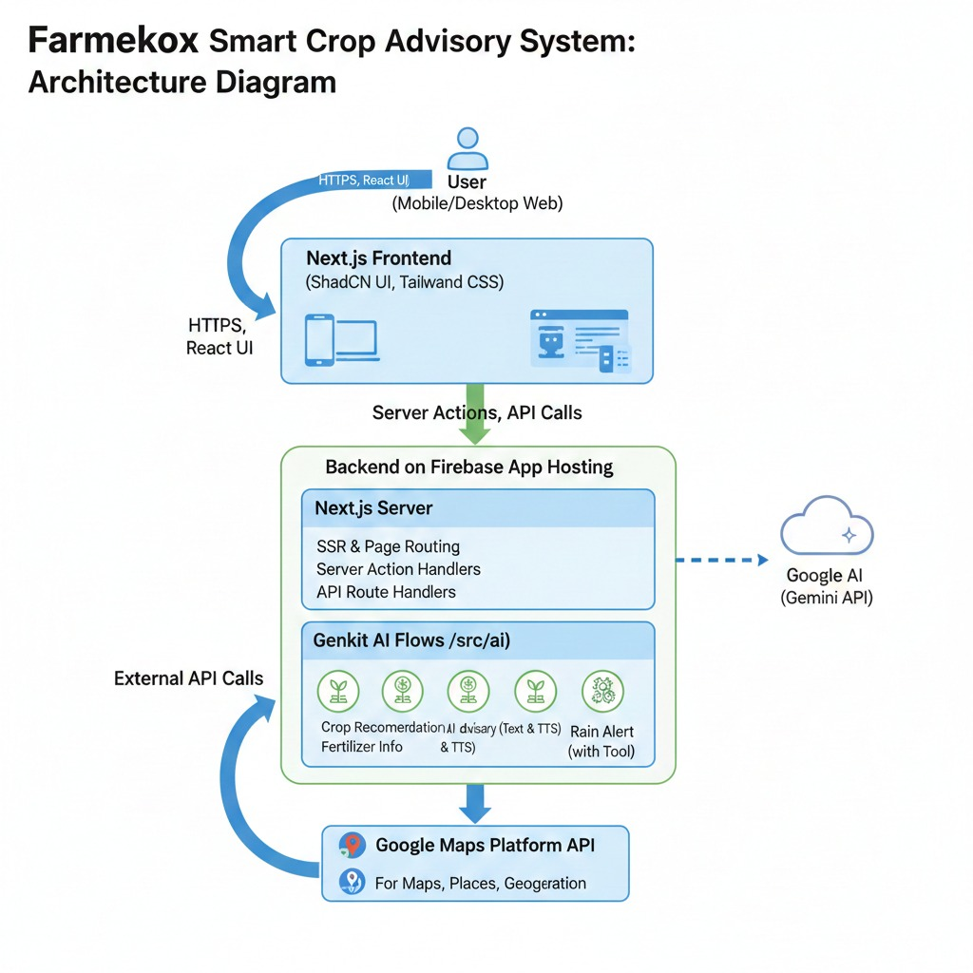
Architecture Diagram

Slide 9
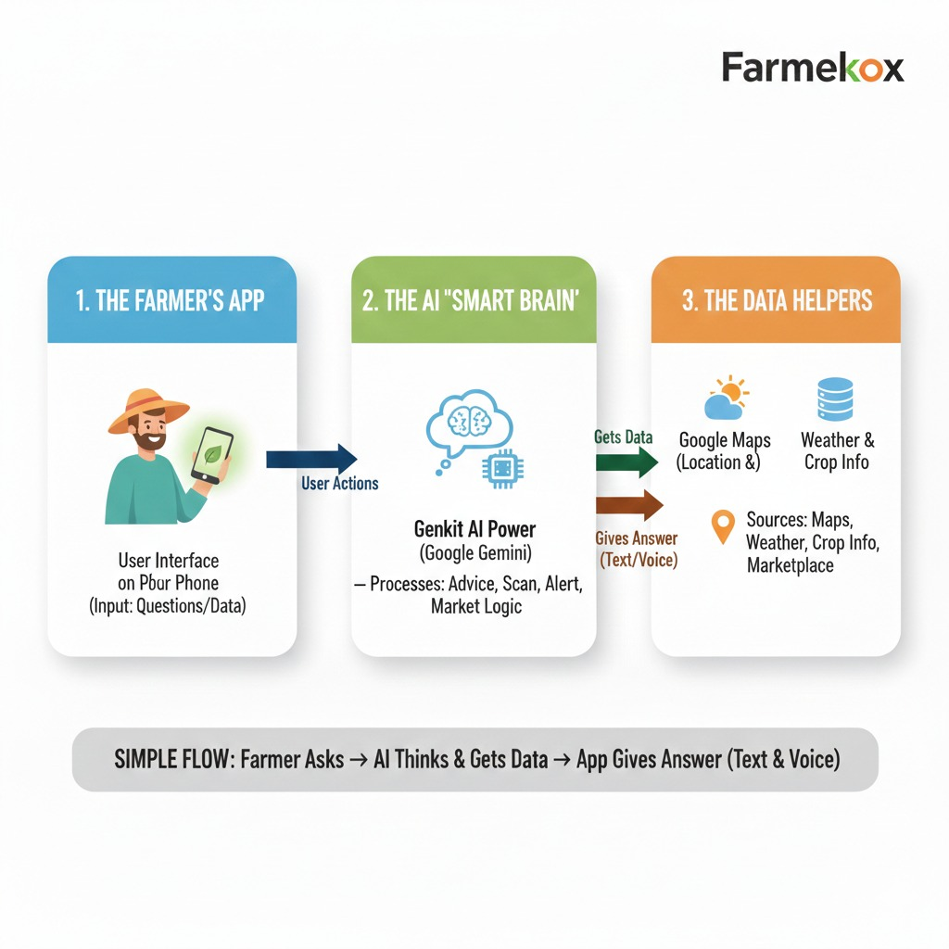
PROPOSED METHODOLOGY

Slide 10
MODULES
Farmekox consists of the following modules:
Dashboard
Crop Recommendation
Crop Calendar
Weather & Irrigation
Fertilizer Calculator
Market Watch
AI Advisory
Ask an Expert
Nearby Resources
Direct Sales

Slide 11
Software details
Frontend: Next.js, React.js, Tailwind CSS, ShadCN UI
Backend: Firebase App Hosting, Node.js
RuntimeAI Framework: Genkit, Google Gemini API
Additional Tools: Zod Schema Validation, Google Maps Platform
API, VS Code / Firebase Studio

Slide 12
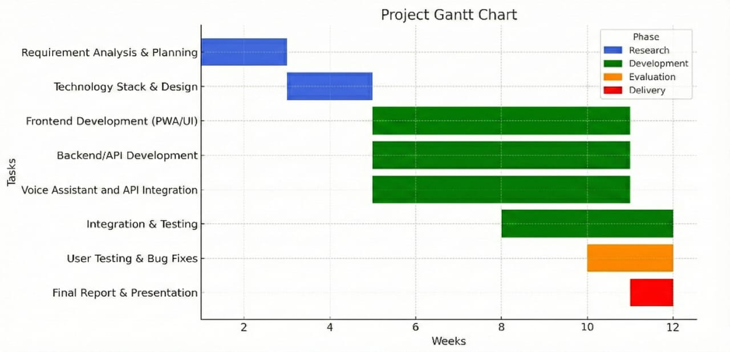
Timeline of the Project (Gantt Chart)

Slide 13
Github Link
Github Link
git@github.com:https://github.com/ArunkumarK572/FarmEkoX

Slide 14
References (IEEE Paper format)
[1] P. Chantima, T. Yarnguy, K. Sarawan, R. Sangmuenmao, W. Sommool, and S. Gonwirut, "Hybrid Intelligence for Field-Scale Soil Analysis and Crop Advisory Using Embedded Sensors and Machine Learning," IEEE Access, vol. 13, pp. 174120–174138, 2025.
[2] A. Khaliq, A. Khan, S. Jan, M. Umair, A. Gulshair, A. Ali, and U. A. Shah, "AI-Driven Smart Agriculture: An Integrated Approach for Soil Analysis, Irrigation, and Crop-Fertilizer Recommendations," IEEE Access, vol. 13, pp. 141124–141138, 2025.
[3] J.-J. Liu, H. Wu, and I. Riaz, "Advanced Technologies for Smart Fertilizer Management in Agriculture: A Review," IEEE Access, vol. 13, pp. 139766–139790, 2025.
[4] R. J. Martin, R. Mittal, V. Malik, F. Jeribi, S. T. Siddiqui, M. A. Hossain, and S. L. Swapna, "XAI-Powered Smart Agriculture Framework for Enhancing Food Productivity and Sustainability," IEEE Access, vol. 12, pp. 168412–168427, 2024.
[5] E. Elbasi, N. Mostafa, Z. Alarnaout, A. I. Zreikat, E. Cina, G. Varghese, A. Shdefat, A. E. Topcu, W. Abdelbaki, S. Mathew, and C. Zaki, "Artificial Intelligence Technology in the Agricultural Sector: A Systematic Literature Review," IEEE Access, vol. 11, pp. 171–202, 2023

Slide 15


